Slide 1




STUDENT PORTFOLIO :
Student name: S.Deepika
Register no and
NMID:24131121802522003&asanm1124131121802522003
Department:B.sc computer science
College Name Aries Arts and science College
University:Annamalai University

Slide 2



PROJECT TITLE :
Student portfolio

Slide 3
AGENDA
01. problem statement
02. Project overview
03. End user
04. Tools and Technologies
05.portfolio design and layout
06. Features and Functionality
07. Results and screenshot
08. Conclusion
09. Github link

Slide 4
PROBLEM STATEMENT
This section defines the main issue or challenge that the project aims to solve. It explains the gap in existing solutions and highlights the importance of addressing the problem. A clear problem statement provides direction and relevance to the project

Slide 5
PROJECT OVERVIEW
This gives a summary of the project, including its purpose, objectives, and scope. It explains what the project is about and sets the foundation for the rest of the discussion. The overview ensures everyone understands the big picture.

Slide 6
END USER
The end user refers to the target audience who will use the project or application. Identifying end users helps in designing solutions that meet their needs and expectations. Their requirements drive the design and features of the project.

Slide 7
TOOLS AND TECHNIQUES
This section lists the software, programming languages, frameworks, or platforms used in the project. It explains why these tools were chosen and how they contribute to development. The right technologies ensure efficiency and effectiveness.

Slide 8
PORTFOLIO DESIGN AND LAYOUT
This covers the structure, appearance, and organization of the portfolio or project interface. A good design ensures clarity, ease of navigation, and user engagement. It also reflects creativity and professionalism.

Slide 9
FEATURES AND FUNCTIONALITY
This highlights the key features offered by the project and how they work. It explains what makes the solution useful and unique. Well-defined functionalities add value and improve user experience.

Slide 10
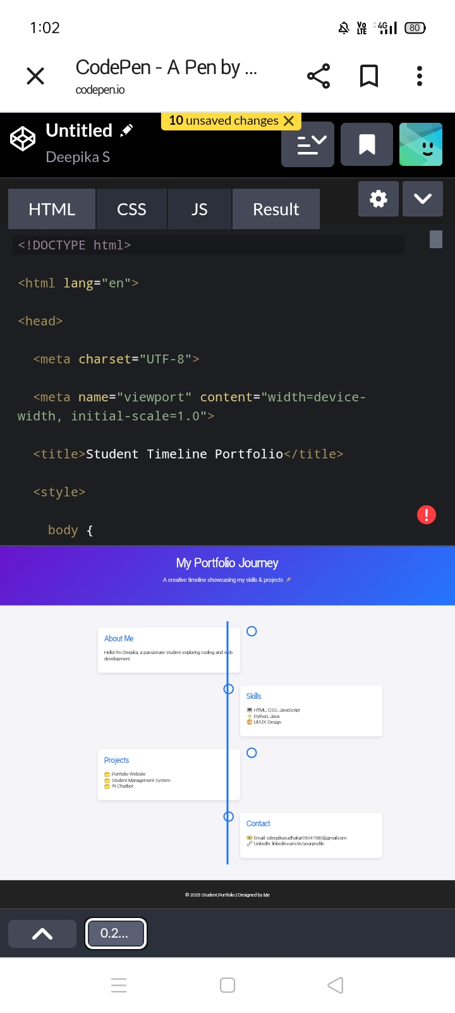
RESULTS AND SCREENSHOT

Slide 11
CONCLUSION
The conclusion summarizes the overall project journey and outcomes. It reflects on the success, limitations, and scope for future improvements. It provides closure while reinforcing the project’s significance.

Slide 12
Thank you

